Slide 1





overall_1_132573879104528179 columns_1_132573879104528179
Microsoft Office Add-ins
Community call
Community engagement update
Word update
Outlook (REST decommission, Shared Folders support, Item multiselect)
SSO samples update
July 13, 2022

Slide 2
Agenda
Community engagement update
Word update
Outlook Add-ins Update (REST decommission, Shared Folders support, Item multiselect)
SSO samples update
Linda Cannon
Yun Wang
Juan Balmori
Victoria Iannotti
David Chesnut
Senior Content Product Manager
Principal Product Manager
Principal Product Manager
Software Engineer
Senior Technical Writer

Slide 3
Community engagement update
Linda Cannon: Senior Content Product Manager

Slide 4
Word update
Yun Wang: Principal Product Manager

Slide 5
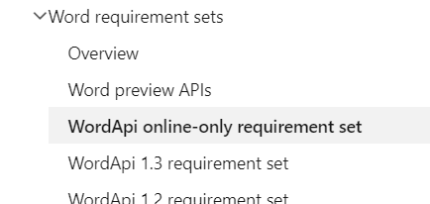
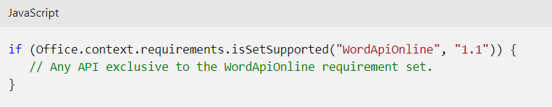
Word JavaScript API online-only requirement set
Online-only is a special requirement set
Includes features that are only available for Word on the web
Considered to be production APIs for the Word on the web application
Delivered faster for APIs
Your Add-in can firstly support Word online, too!
Considered to be "preview" APIs for other platforms (Windows, Mac, etc.)
The goal is to keep all the platforms with the same APIs
Exceptions can happen
Online-only: Three feature areas are available
Newly added: Footnotes and endnotes support
Go to Office Add-ins community call – February 9, 2022 (pnp.github.io) for additional information about Comments and Track changes
Feature area | Description | Relevant objects
Comments | Manage comments and replies. | Comment, CommentCollection, CommentContentRange, CommentReply, CommentReplyCollection
Footnotes and endnotes | Manage footnotes and endnotes. | NoteItem, NoteItemCollection
Track changes | Manage settings for reviewing changes. | Document.ChangeTrackingMode

Slide 6
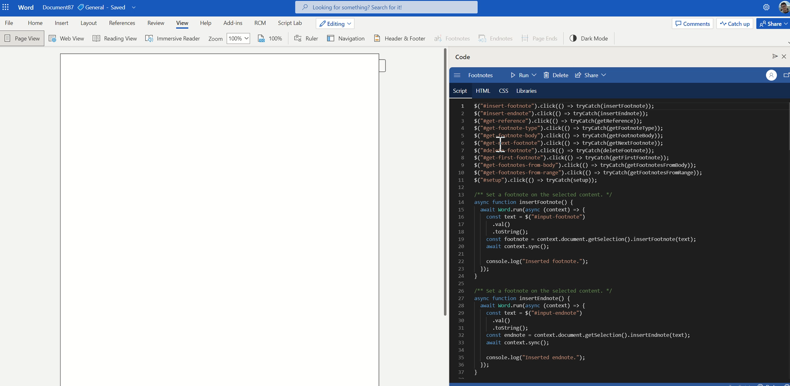
In Online-only: Footnotes and Endnotes APIs
Insert footnotes/endnotes via Range object
Get collections of footnotes/endnotes via Body, ContentControl, Paragraph, Range, Table and TableRow objects
Navigate and operate footnotes/endnotes via NoteItemCollection and NoteItem objects

Slide 7
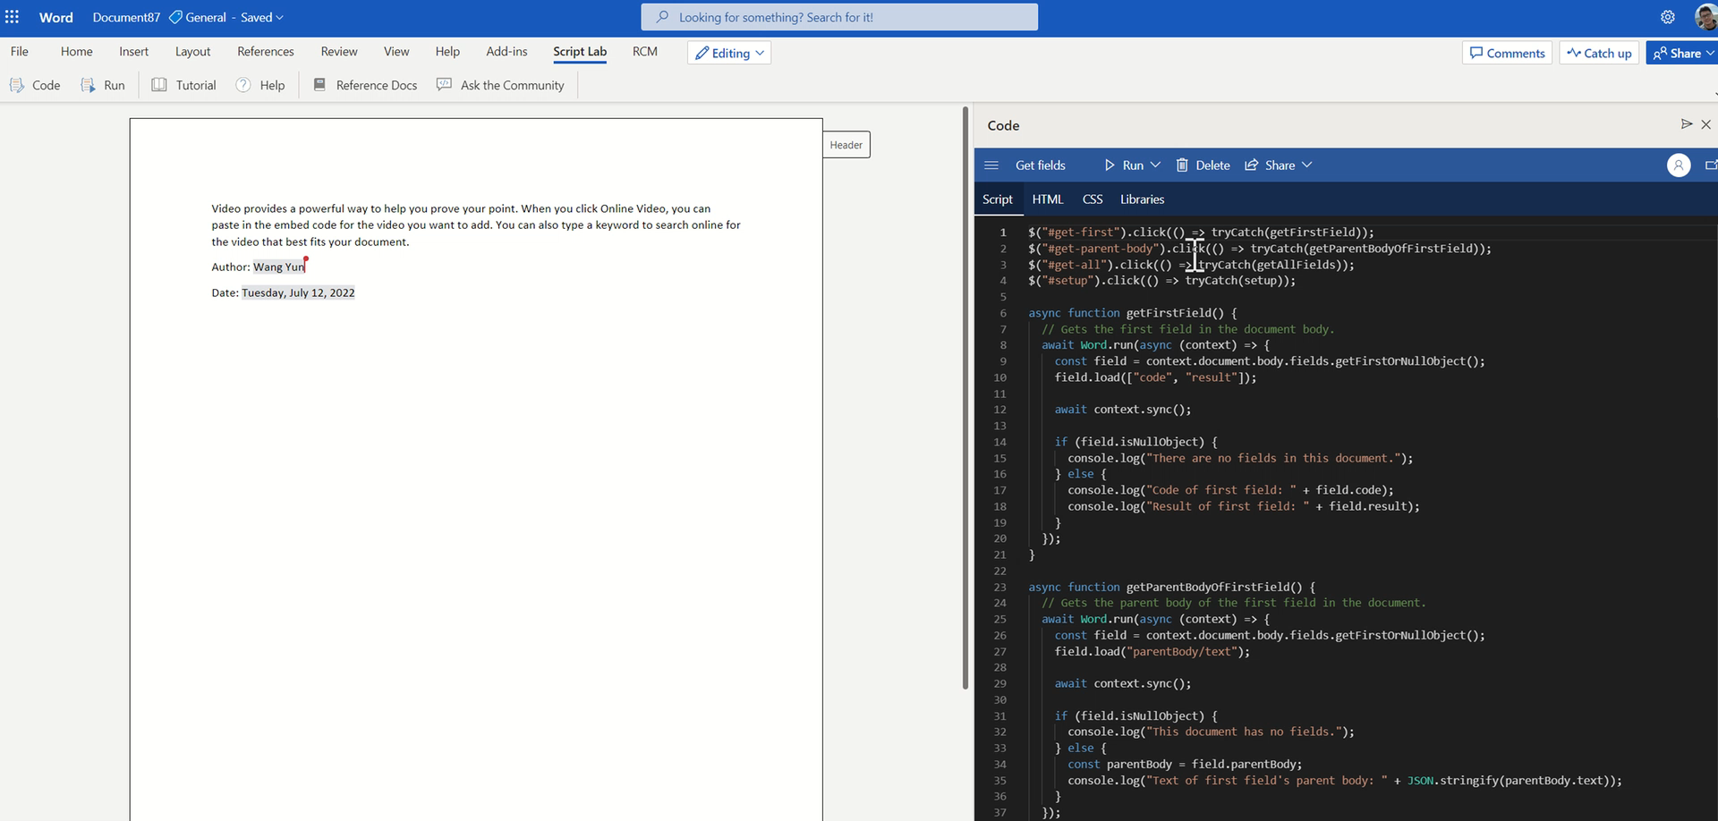
In Web-only Preview: Fields APIs
Get collections of fields via Body, Paragraph, Range, Table and TableRow objects
Navigate fields via FieldCollection and Field objects

Slide 8

Coming next
Candidates for next GA release (all platforms support)
Track changes
Comments
Fields (only get APIs)
Bookmarks
CustomXmlPart
Setting
Tell us what do you expect.

Slide 9
Outlook Add-ins Update!
Juan Balmori: Principal Product Manager
Victoria Iannotti: Software Engineer

Slide 10
Outlook Add-ins news
REST Decommission Update
Support for Shared Folders, Delegates and Shared Mailbox in Exchange OnPrem!
Support for Item Multiselect!

Slide 11
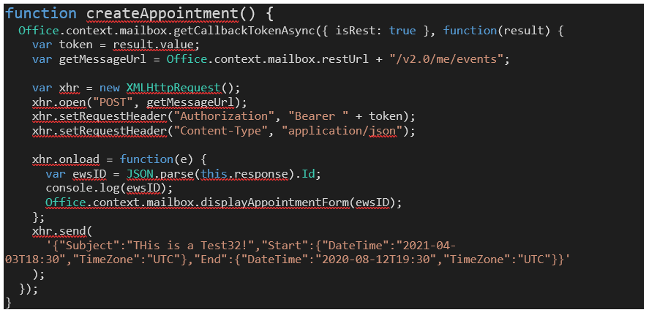
Some Context: Back in February we shared:
On Nov 30^{th,} 2022, the Outlook REST V2 Endpoint will be decommissioned.
Impacts Exchange Online, and Exchange OnPrem on Hybrid.
Scenarios impacted
Using the REST APIs
Delegate Scenarios using REST

Slide 12
Summary of APIs Impacted
API [Requirement Set] | Scenario | Impact for New Add-ins after decommission date
Mailbox.getCallBackTokenAsync with isRest option. [1.5] | Gets a REST compatible token | Call will fail Use Graph as alternative. (SSO and get Graph compatible token) Use EWS if Graph fails.
Mailbox.restUrl [1.5] | Property used to create the url portion of the REST expression.
Office.MailboxEnums.RestVersion [1.3] | Enum used on the convert id methods. | Will become deprecated.
mailbox.convertToRestId() [1.3] | Converts an EWS formatted Id into the proper [for the rest version] REST id. | Might still be useful for Graph
Mailbox.convertToEwsId() [1.3] | Converts an REST formatted id [for a specific REST version] into EWS | Might still be useful for Graph
SharedProperties.targetRestUrl [1.8] | Used to perform operations as delegate. | Use Graph as alternative Use EWS if Graph fails.

Slide 13
Where we are?
Good news: all active Add-ins using REST will be granted exceptions to keep using the service until Office 2019 goes out of support (October 14,2025) ​
Add-ins created after the decommissioned date will not be able to use the REST service after November 2022.​(*)
They need to use the graph instead.
We will automatically ID traffic coming from Add-ins but we are also enabling an allow list: https://aka.ms/RESTCheck
(*) This might change

Slide 14
Issues
Performance Issues (REST faster than Graph in some cases)
Authentication issues.
Latency of using a Middle tier for route Graph Calls.
Mobile not Supporting SSO (Identify 1.3) -> Requires MSAL AuthRedirect flow.
Graph API Gaps? Not detected so far.
If you are experiencing ANY of this (or other issues) please contact me ASAP: juanbl@microsoft.com

Slide 15
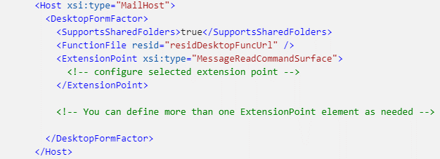
Shared Folders in On Exchange OnPrem: in beta! (win32 16.0.15505.20000)
Context: Shared Folders (delegates), Shared Mailbox shipped back in Mailbox 1.8 supported only in Exchange Online
Available in Beta NOW!
Commands should be visible
SharedProperties APIs should work (except REST in non hybrid)
Call to Action: Help us validate it works as you expect. Send an issue to https://github.com/OfficeDev/office-js/issues/
Notes:
Enable shared folders and shared mailbox scenarios in an Outlook add-in - Office Add-ins | Microsoft Docs

Slide 16
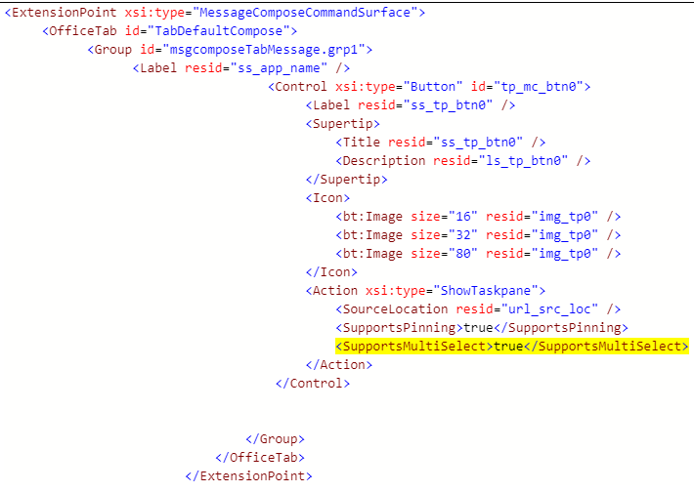
Item Multiselect: This is coming soon….

Slide 17
Demo Item Multi-Select
Victoria Iannotti - Software Engineer

Slide 18
SSO samples update
David Chesnut: Senior Technical Writer

Slide 19
Demo: Hello World in SSO

Slide 20


SSO with OBO (successful flow)
Add-in
Middle-tier server
Office host
Microsoft identity
platform
Microsoft Graph
1. getAccessToken()
2. Office returns token
3. Call REST API
4. OBO flow
5. Identity returns Graph token
6. Call Graph
{…}
7. Returns data
8. Returns data
{…}

Slide 21
SSO fails and must use MSAL (fallback flow)
Add-in
Middle-tier server
Office host
Microsoft identity
platform
Microsoft Graph
1. getAccessToken()
2. Error returned
3. Open dialog box and sign in user (oauth 2 flow)
5. Identity returns access token
6. Call REST API
7. OBO flow
8. Identity returns Graph token
9. Call Graph
{…}
10. Returns data
{…}
11. Returns data

Slide 22

e
SSO token expired flow)
Add-in
Middle-tier server
Office host
Microsoft identity
platform
Microsoft Graph
1. getAccessToken()
2. Office returns token
3. Call REST API
4. OBO flow
6. Return error to client
5. Error: Token expired
7. Call getAccessToken() again
8. Office requests updated token
9. Identity returns updated token
10. Office returns token
11. Call REST API
{OBO flow continues from here}
Notes:
Middle-tier is the confidential client (just mention)
Add-in is the public client.

Slide 23
Demo: Key parts of the code

Slide 24
Important security notes
Never cache tokens yourself. Always call getAccessToken() or use MSAL caching.
Never return tokens from the middle-tier back to the client.
Always validate the access token passed to your REST APIs. Consider a well known client list.
Client secret should be stored securely (such as in Azure key vault).

Slide 25


Community spotlight
Thank you!
Maarten van Stam
https://github.com/OfficeDev/Office-Add-in-samples
https://pnp.github.io/recognitionprogram/

Slide 26
Community panels
Panel | Link
Outlook add-ins | https://ux.microsoft.com/Panel/OutlookAddinDeveloper
Excel add-ins | https://ux.microsoft.com/Panel/ExcelAddinDeveloper
Word add-ins | https://ux.microsoft.com/Panel/WordAddinDeveloper
PowerPoint add-ins | https://ux.microsoft.com/Panel/PowerPointAddinDeveloper
Samples and docs | https://ux.microsoft.com/Panel/OfficeAddinImproveSamplesDocs

Slide 27
Samples and docs panel
July 27th 8am PT (2 weeks from today)
Please join us and let us know what you need most from samples for Office Add-ins.
Get the calendar invite:
https://aka.ms/officeaddinsamples-call
Join the teams meeting:
https://aka.ms/officeaddinsamples-join

Slide 28
What can you tell us about the approach and timing of the upcoming integration of Loop components with Excel?
Answer:
There isn't anything on the roadmap to share at this time. If you have ideas or requests please create a feature request with more information at https://aka.ms/m365dev-suggestions.
Q&A

Slide 29
Is there a way we can create desktop shortcuts for MS Office Add-ins (specifically for Word)?
Answer:
If you are referring to keyboard shortcuts, yes, but this is only available in Excel today. You can find more information in https://docs.microsoft.com/office/dev/add-ins/design/keyboard-shortcuts. If you are looking for keyboard shortcut support in Word, please let us know more about your scenario in a feature request at https://aka.ms/m365dev-suggestions.
Q&A

Slide 30
I have two questions both relating to getAccessToken:
1. Can you clarify which namespace we should be using to access the getAccessToken method please ? Is it OfficeRuntime.Auth.getAccessToken or Office.auth.getAccessToken
2. Why does the documentation refer to Office.auth when the full namespace is Office.context.auth? Can you confirm the full namespace?
Answer:
1. You can use either namespace. They call the same code as one just maps to the other. However, for consistency throughout the docs and samples, we are updating to always use Office.auth.getAccesstoken. It is possible that if a change were made in the future (like adding a new method) it may not appear on the original OfficeRuntime namespace. However any code using OfficeRuntime will not break. So if you are already using OfficeRuntime, you do not need to rewrite your code.
2. The correct namespace is Office.auth.getAccessToken.
Q&A

Slide 31
Is there a way for admin to install Excel add-in for the user or group that will show only for some Excel files generated by our application and not when user creates new Excel file or some other Excel files opened by the user?
Answer:
It isn't possible to conditionally install an add-in based on various conditions about the opened file. You can however enable functionality in your add-in based on the conditions you want to detect. See https://docs.microsoft.com/office/dev/add-ins/develop/run-code-on-document-open.
You can also show the task pane or hide the task pane based on conditions you define. See https://docs.microsoft.com/office/dev/add-ins/develop/show-hide-add-in.
You can also embed your add-in into an Excel spreadsheet if opening the file from your service. See https://docs.microsoft.com/en-us/office/dev/add-ins/excel/pnp-open-in-excel
If you need more capabilities, please create an idea request with more details about your scenario at https://aka.ms/m365dev-suggestions.
Q&A

Slide 32
I have registered a request with https://aka.ms/RESTCheck but have not received any response. If there is no response via email, does this mean that the add-in that registered the information is not eligible for the REST extension?
Answer:
…
Q&A

Slide 33



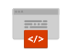


New to Office Add-ins?
 | Documentation | https://aka.ms/office-add-ins-docs
 | Quick starts | Outlook, Excel, Word, PowerPoint
 | Script Lab | https://aka.ms/getscriptlab
 | Samples | https://aka.ms/officeaddinsamples
 | Microsoft 365 Developer Program | https://aka.ms/M365devprogram
 | Office Scripts | aka.ms/office-scripts-docs
Notes:
m365-dev-sig

Slide 34
Engage with the team
Engagement | Where to go
Technical questions about Office Add-ins | https://aka.ms/office-addins-dev-questions [office-js-dev] [office-addins-dev] https://stackoverflow.com [office-js] [outlook-web-addins] [office-scripts]
Product bugs | https://github.com/OfficeDev/office-js
Feature requests and ideas | https://aka.ms/m365dev-suggestions
Send a Smile or Frown | Inside Office
Notes:
m365-dev-sig

Slide 35
Microsoft 365 developer community calls
Microsoft 365 platform call (weekly) https://aka.ms/m365-dev-call (Notice. This call is on a summer break between July 1st and 31st of August 2022)
Adaptive Cards (monthly) https://aka.ms/adaptivecardscommunitycall
Microsoft identity platform (monthly) https://aka.ms/IDDevCommunityCalendar
Office Add-ins (monthly) https://aka.ms/officeaddinscommunitycall
Power Platform (monthly) https://aka.ms/PowerPlatformMonthlyCall
Microsoft 365 & Power Platform Development (bi-weekly) https://aka.ms/m365-dev-sig
Viva Connections &
SharePoint Framework (bi-weekly) https://aka.ms/spdev-spfx-call
All calls and assets: https://aka.ms/m365pnp
Notes:
m365-dev-sig

Slide 36
Thank you
Recording will be available in 24 hours on
Microsoft 365 Community (PnP) YouTube channel
https://aka.ms/M365PnP/videos
(subscribe today)
Follow us on Twitter
@Microsoft365Dev | @M365PnP
Next call: August 10th at 8:00 AM Pacific Time
https://aka.ms/officeaddinscommunitycall
Agenda: https://aka.ms/officeaddinsagenda
Submit your questions: https://aka.ms/officeaddinsform

